Slide 1
Biweekly Update
February 15, 2023
The Little Engineers that Could: Blake, Sam, Melanie, and Amy

Slide 2
Progress
01
02
03
Ordering Parts
CAD
Writing

Slide 3
Ordering Parts
Initial purchases from Filabot were made, planning purchases from McMaster Carr
Need to see the true size of screw from Filabot to have proper flight clearance before ordering barrel and other components
Have all necessary parts laid out, just finding pricing on some of them
Parts that need to be machined David will be able to fabricate for us as long as we provide materials

Slide 4
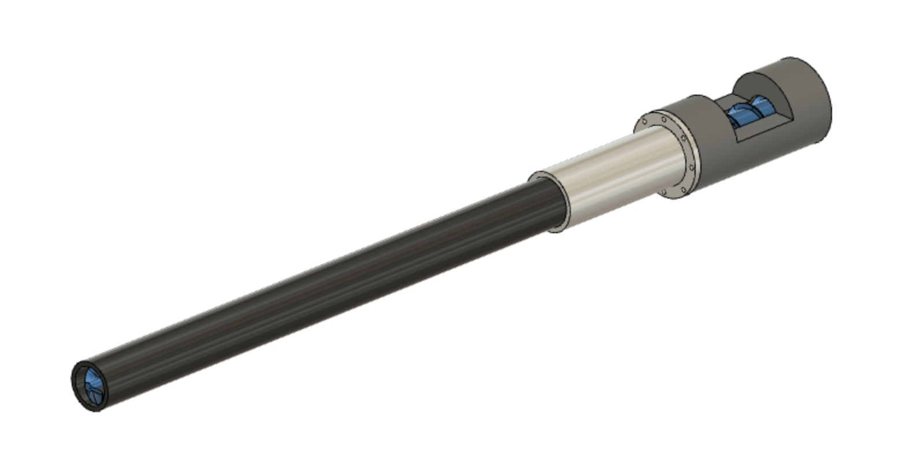
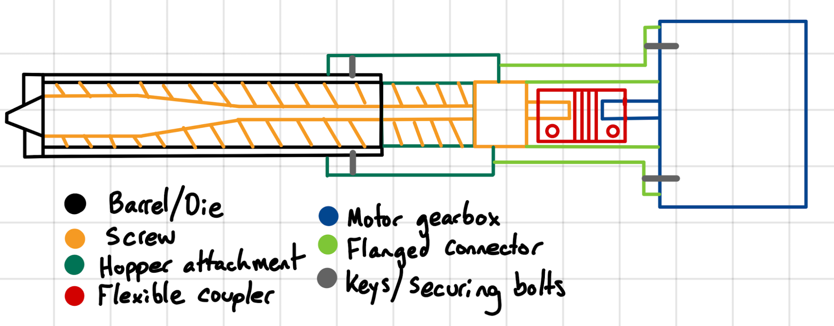
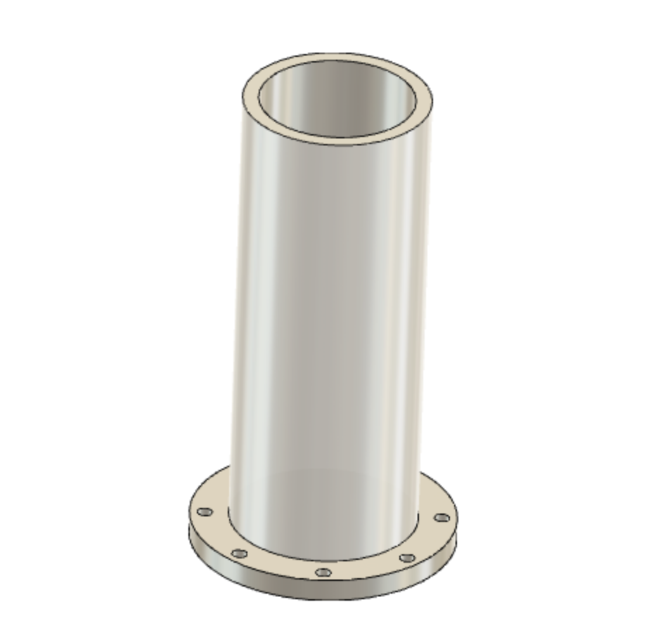
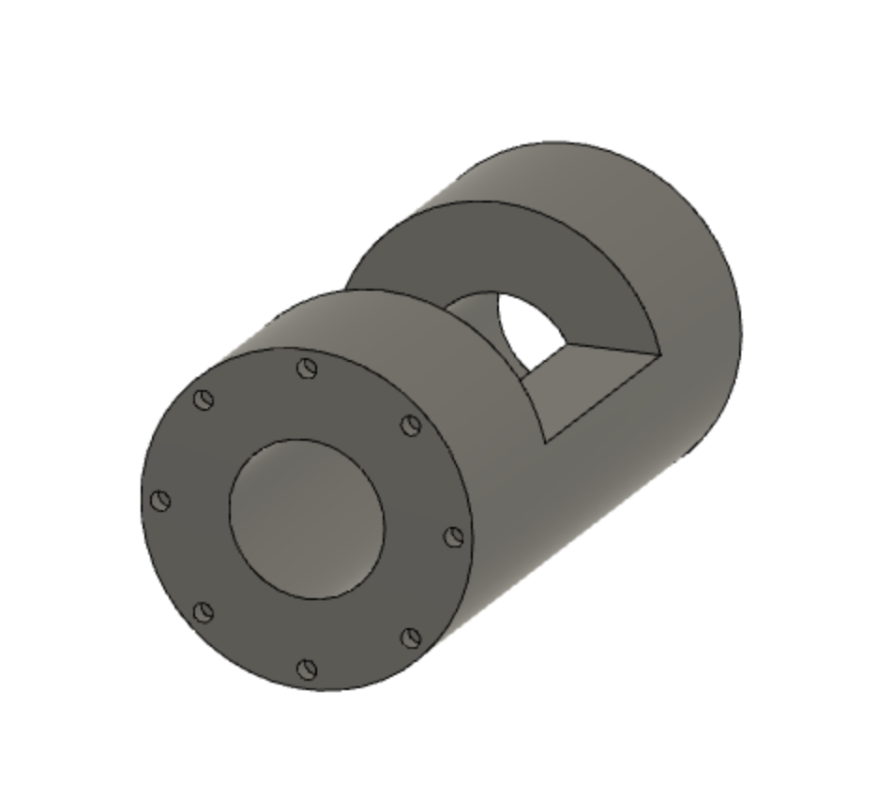
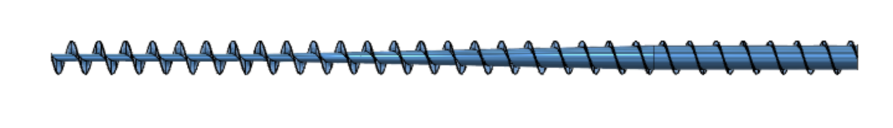
CAD Modeling
Notes:
Notes for this Slide:
Made initial drawing of assembly of components, what parts we need to design (top left)
Bottom left, flanged portion that will need to be welded to barrel to attach to the part on the bottom right
Bottom right, coupler between barrel and hopper, has exposed section for where the pellets can be fed into the screw
David can fabricate the bottom left and bottom right parts, need to still design parts for connecting screw components to the gearbox

Slide 5
Our first batch of bottles is here!
A trash bag full of bottles has been delivered by Vandy recycling
We have started washing and making regrind out of some of the bottles
The bag they gave us has a wide variety of brands, and we were unsure of whether we wanted to mix them
We are concerned different brands may have different percentages of recycled PET or possibly other materials
So far, we have only used Coke and Sprite bottles, since we believe these are the same as the bottles we have been using so far

Slide 6
Writing
HAZOP Analysis
Gantt Chart

Slide 7
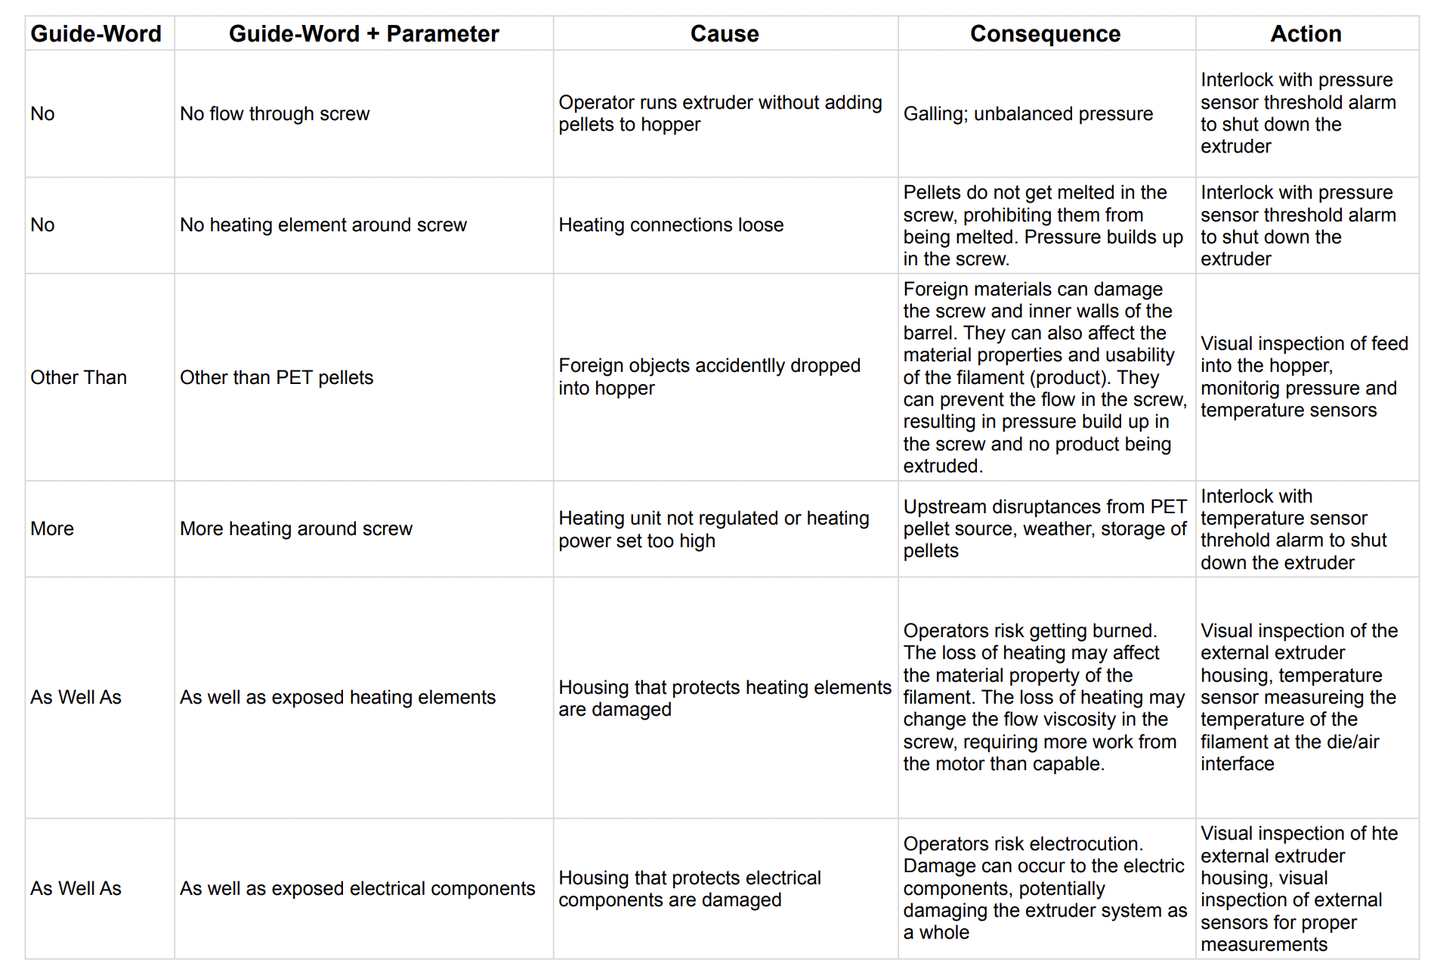
HAZOP Analysis
Questions
PET pellets or regrind as input
Prototype extruder or ideal scale up extruder (plant level)

Slide 8
Gantt Chart
See google sheets → used timeline function
Struggle using google sheets to make traditional chart
Will continue updating chart & finding a new way to represent visual timeline

Slide 9
Action Items (2 weeks)
Run the EX2 with Regrind – Wednesday with David
Finish designing other parts to be machined by David, confirm that they are ok to machine
Finish creating list of materials we need to purchase from McMaster Carr
Once Filabot parts arrive, find actual dimensions of the screw
Order barrel and other components from McMaster Carr once we have proper sizing
Continue working on the writing

Slide 10
Purchases
Item Name | ID | Unit Cost | Quantity | Total Cost | Source
Poly(ethylene terephthalate) | 429252-250G | $106.00 | 1 | $106.00 | Sigma Aldrich
PET Bottle Recycler | Link | $286.00 | 1 | $286.00 | ebay
EX6 and MDPE10 extruder screws | EX6-120-C3 | $869.00 | 1 | $869.00 | FilaBot
Notes:
-quote from CT Polymers & Wood Mckenzie for recycled PET pellets

Slide 11
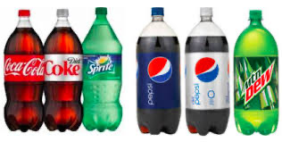
“Practice makes perfect”
Voltaire

